Slide 1
Welcome to My Presentation

Slide 2

Title:
A Report About Unilever Consumer Care Limited
Name: MD. AL MARUF
Batch No: 21
Roll: 01-021-15
Department of Political Science
Date: October 04, 2024

Slide 3
…
Overview:
Unilever PLC is a British multinational fast-moving consumer goods company founded on 2 September 1929 following the merger of British soap maker Lever Brothers and Dutch margarine producer Margarine Uni. It is headquartered in London, England. The company's products include baby food, beauty products, bottled water, breakfast cereals, cleaning agents, condiments, dairy products, energy drinks, healthcare and hygiene products, ice cream, instant coffee, instant noodles, pet food, pharmaceuticals, soft drinks, tea, and toothpaste.

Slide 4
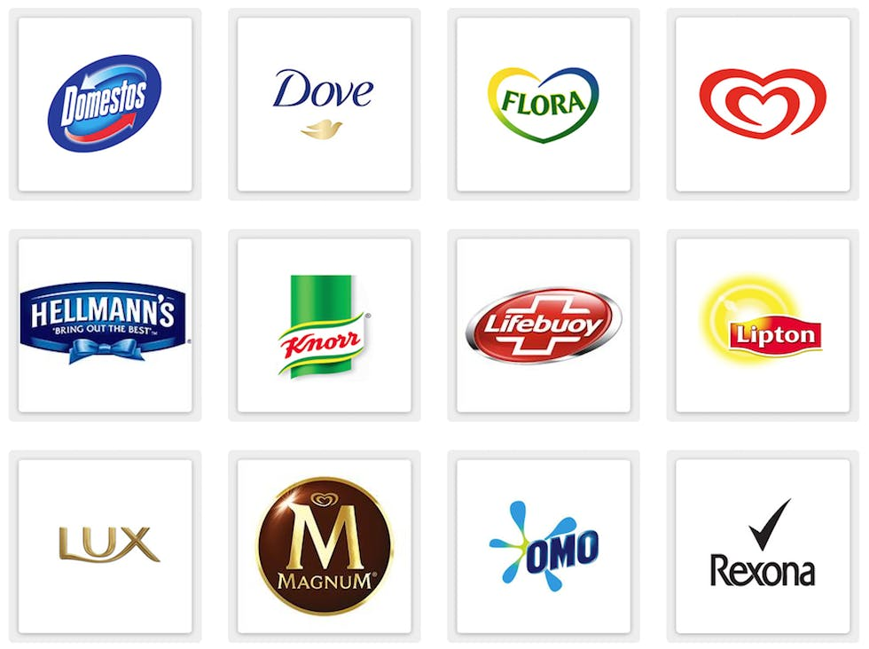
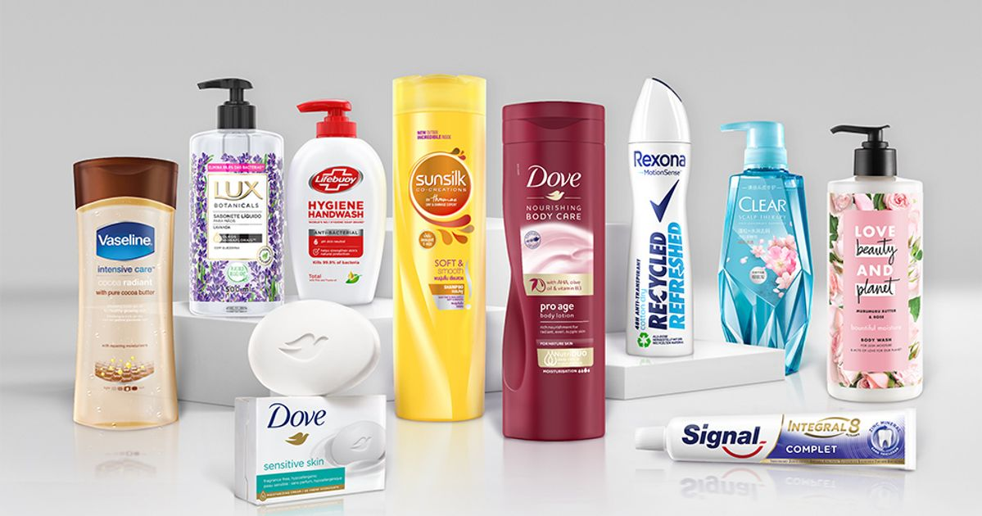
Products/Services:
Here I Include some of key Product of Unilever-

Slide 5
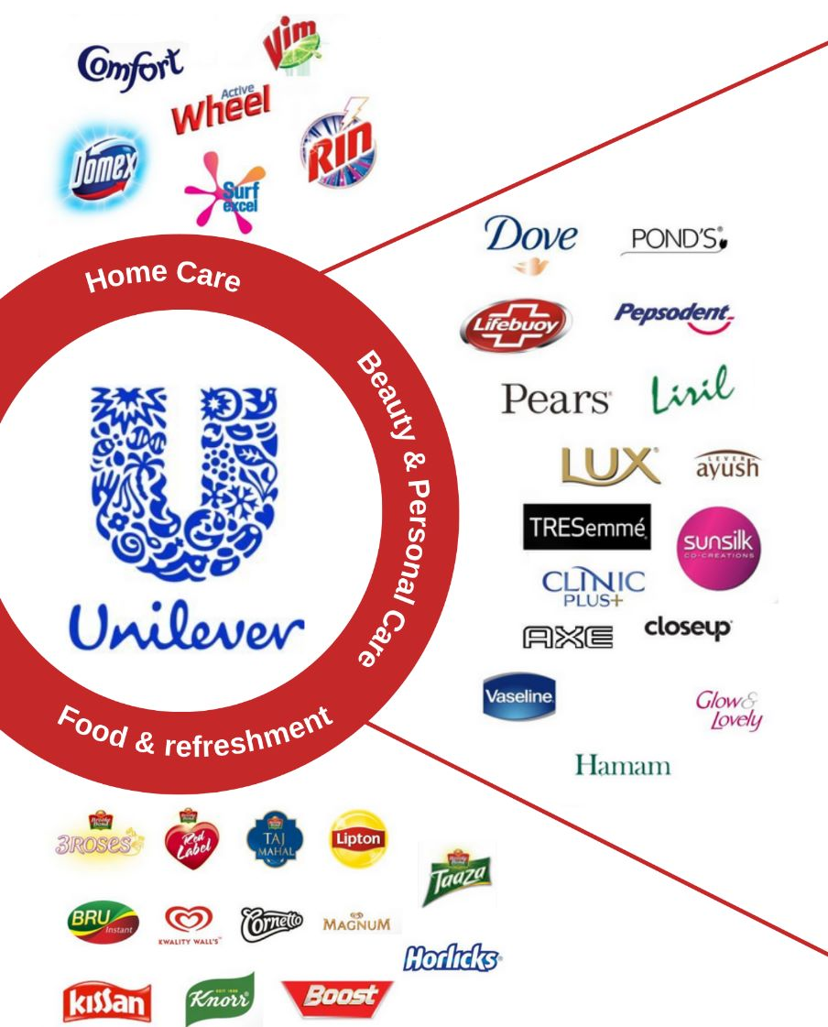
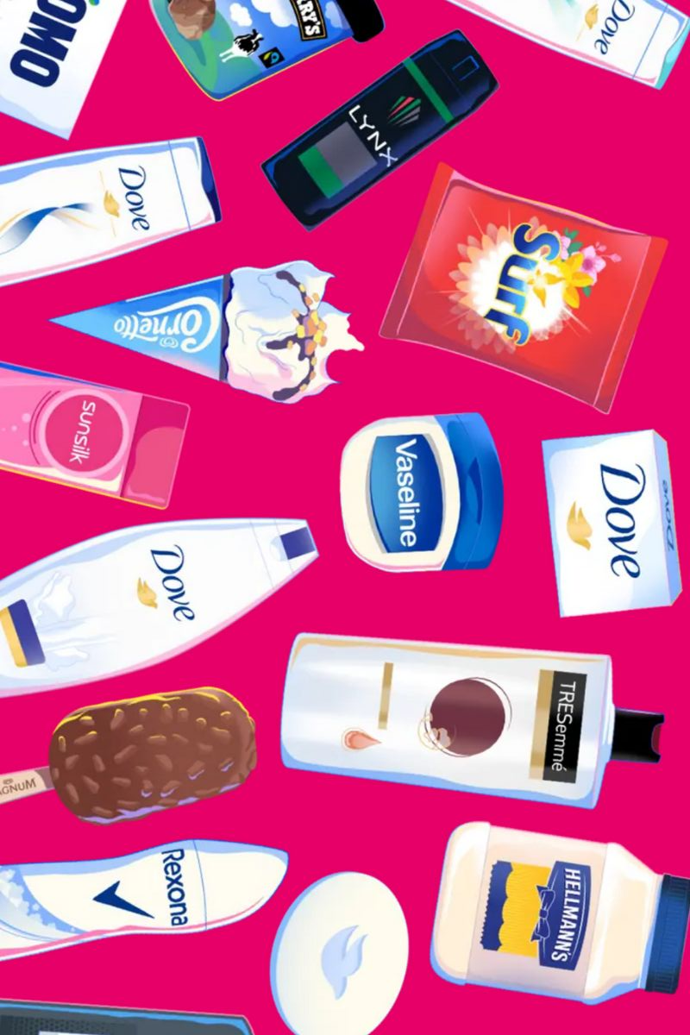

Slide 6
Some of these are most popular product in BD:
4)Lifebuoy
6) Clinic Plus
5) Wheel
7)Pepsodent
1) Dove
2) Knorr
3)Lux

Slide 7

Advertisement:

Slide 8
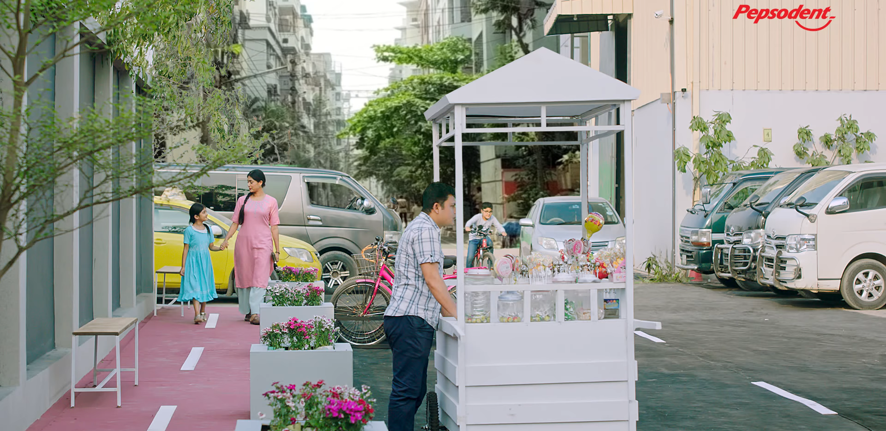
Another Advertise From Unilever Brand

Slide 9
Analysis: Here I present Company’s Statistical data Value and data graph chart with it’s Revenue.
Year | Cost of Good Sold | Revenue | Revenue%
2021 | 34.44 B | 59.69 B | 57.70%
2022 | 34.447 B | 64.325 B | 59.80%
2023 | 65.803 B | 65.803 B | 57.80%

Slide 10
Conclusions Remarks:
Unilever, a multinational consumer goods company, has established a significant presence in the global market with its diverse range of products. Through its focus on sustainable practices and consumer needs, Unilever has successfully positioned itself as a leading player in various industries. The company's commitment to innovation and social responsibility has contributed to its enduring success and positive impact on communities worldwide.

Slide 11
That’s all of My Presentation
Thank You

